Slide 1
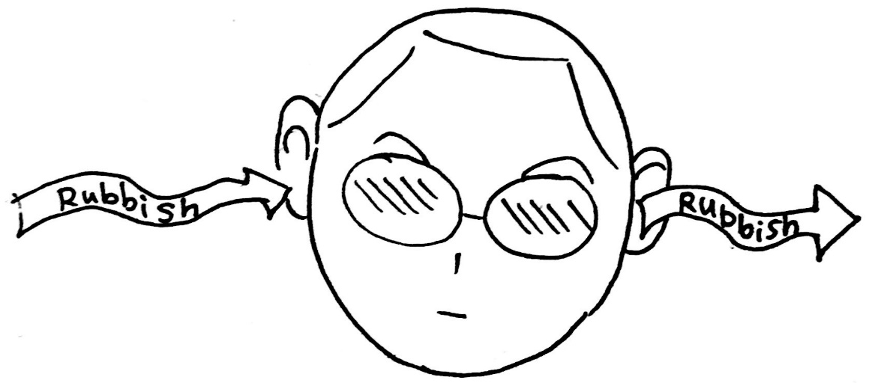
Introduction to the Q-robot
A trusted friend to avoid Rubbish in, Rubbish out
Qiang Li, Group Seminar, 2019-05-16

Slide 2
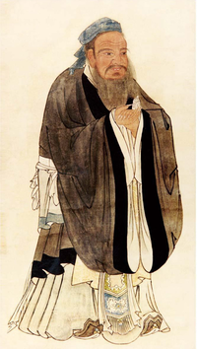
The mechanic,
who wishes to do his work well,
must first sharpen his tools. Confucius (551–479 BC)

Slide 3

Previous Introduction
Rubbish – IN
INCAR: ALGO, ISMEAR, vdW, DFT+U, EDIFF(G)
KPOINTS: Γ-centered, K*a, Line mode
POSCAR: Structure with Physical meanings
POTCAR: In consistent with POSCAR
Script: queue, version, cores
Rubbish – OUT
Errors/Wrong Results
Hanging in the queue
None-Physical results
Waste your time/resources
Waste others’ time/resources
Workhorse
What is Q-robot?
-- A bunch of python/bash scripts with element operations;
-- A DIY Assistant; A TRUSTED Friend
What Can Q-robot do?
Check/Generate initial inputs (Avoid Rubbish--IN);
Build geometries from commands (supervised model);
Analysis outputs (Geometric, Electronic)

Slide 4



How to install the Q-robot？
Step1: Get the Q-robot
https://gitlab.com/iciq-tcc/nlopez-group/q-robot
Step2: Bring him home
qli@p015:~$ ls ~/bin/Q_robot/
actions books brain friends reports
Step3: Activate him
Add two lines to ~/.bashrc file
export PYTHONPATH="$PYTHONPATH:$HOME/bin/Q_robot/brain"
export PATH=$PATH:$HOME/bin/Q_robot/actions

Slide 5
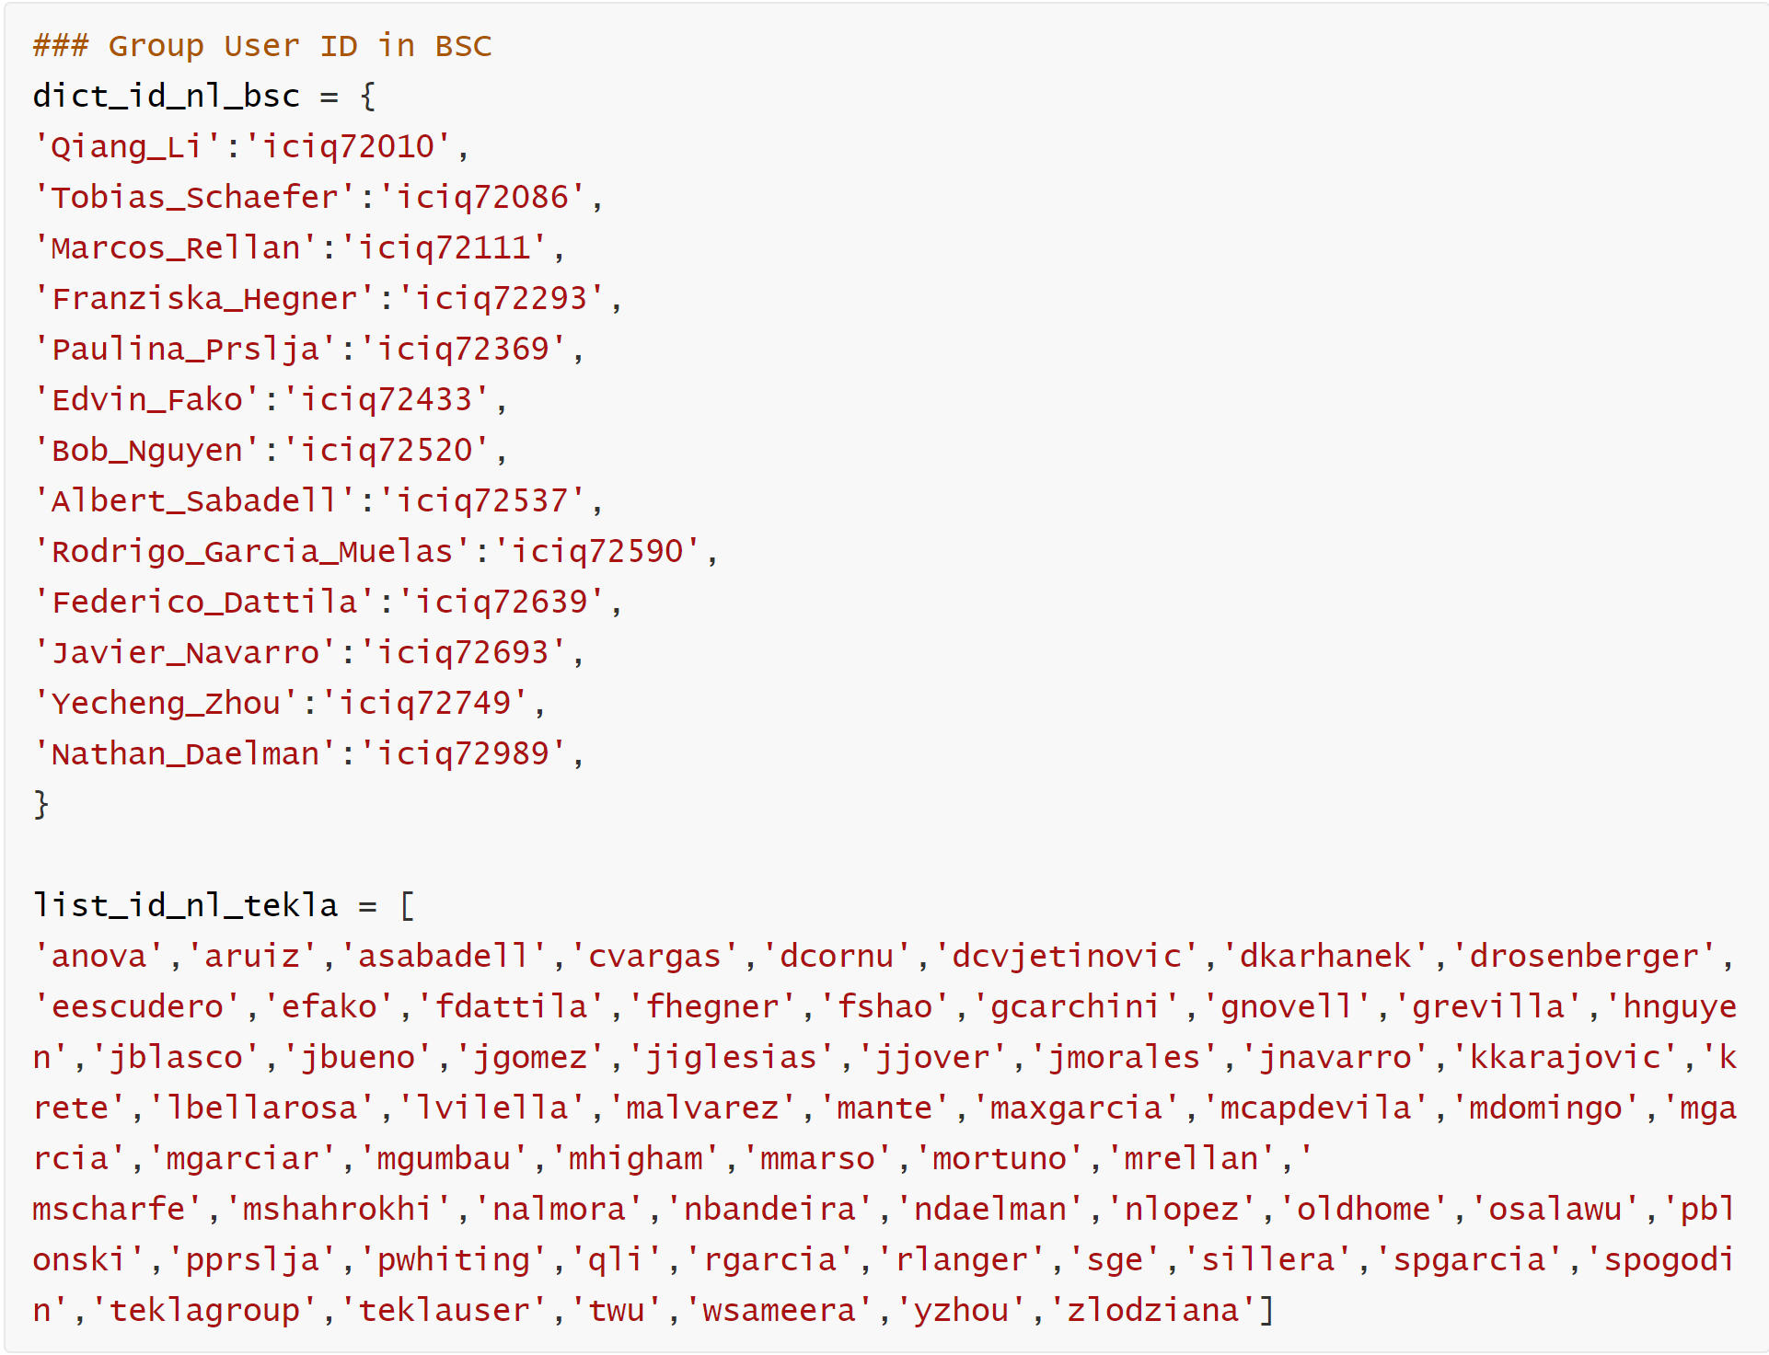

How to install the Q-robot？
Step4: Make friends
Add your account to
~/bin/Q_robot/brain/data.py

Slide 6
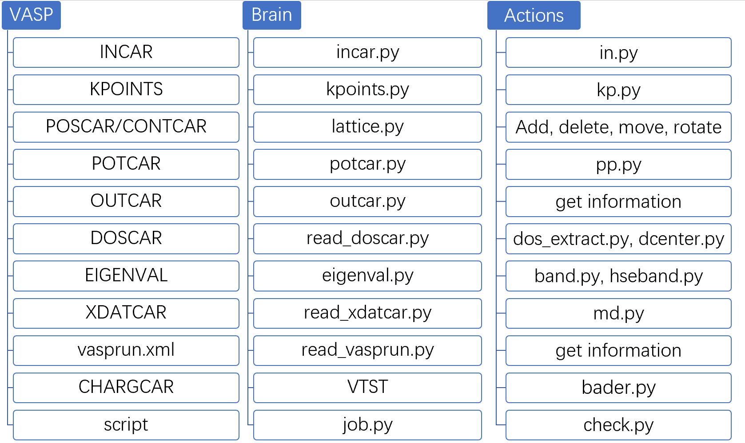
The Brain controls the actions

Slide 7
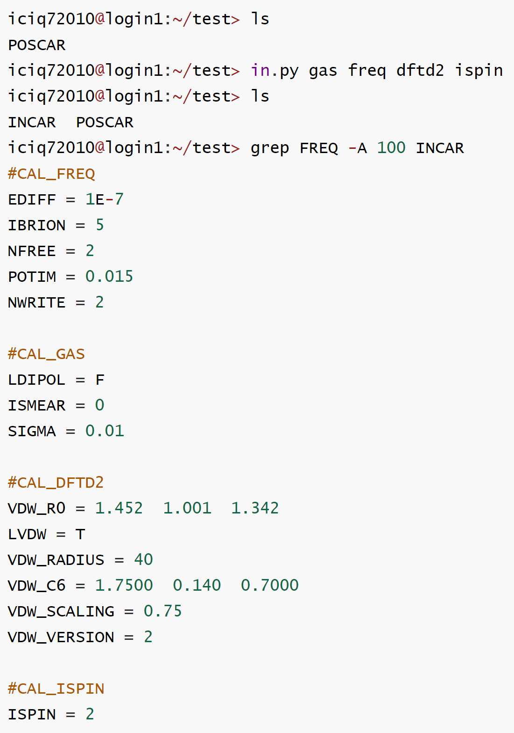
INCAR
INPUTS
To Generate the INCAR file
in.py task1 task2 ...
Supported tasks so far:
single, gas, bulk, dipole, ispin
dftu, electronic, dos, dftd2, dftd3, workfunction, freq, dimer, tsopt, neb, md, hse03, hse06, b3lyp, pbe0, hf, optb88, optb86b, vdwdf2, optpbe, vdwdf, scan+rvv10, rvdwdf2

Slide 8
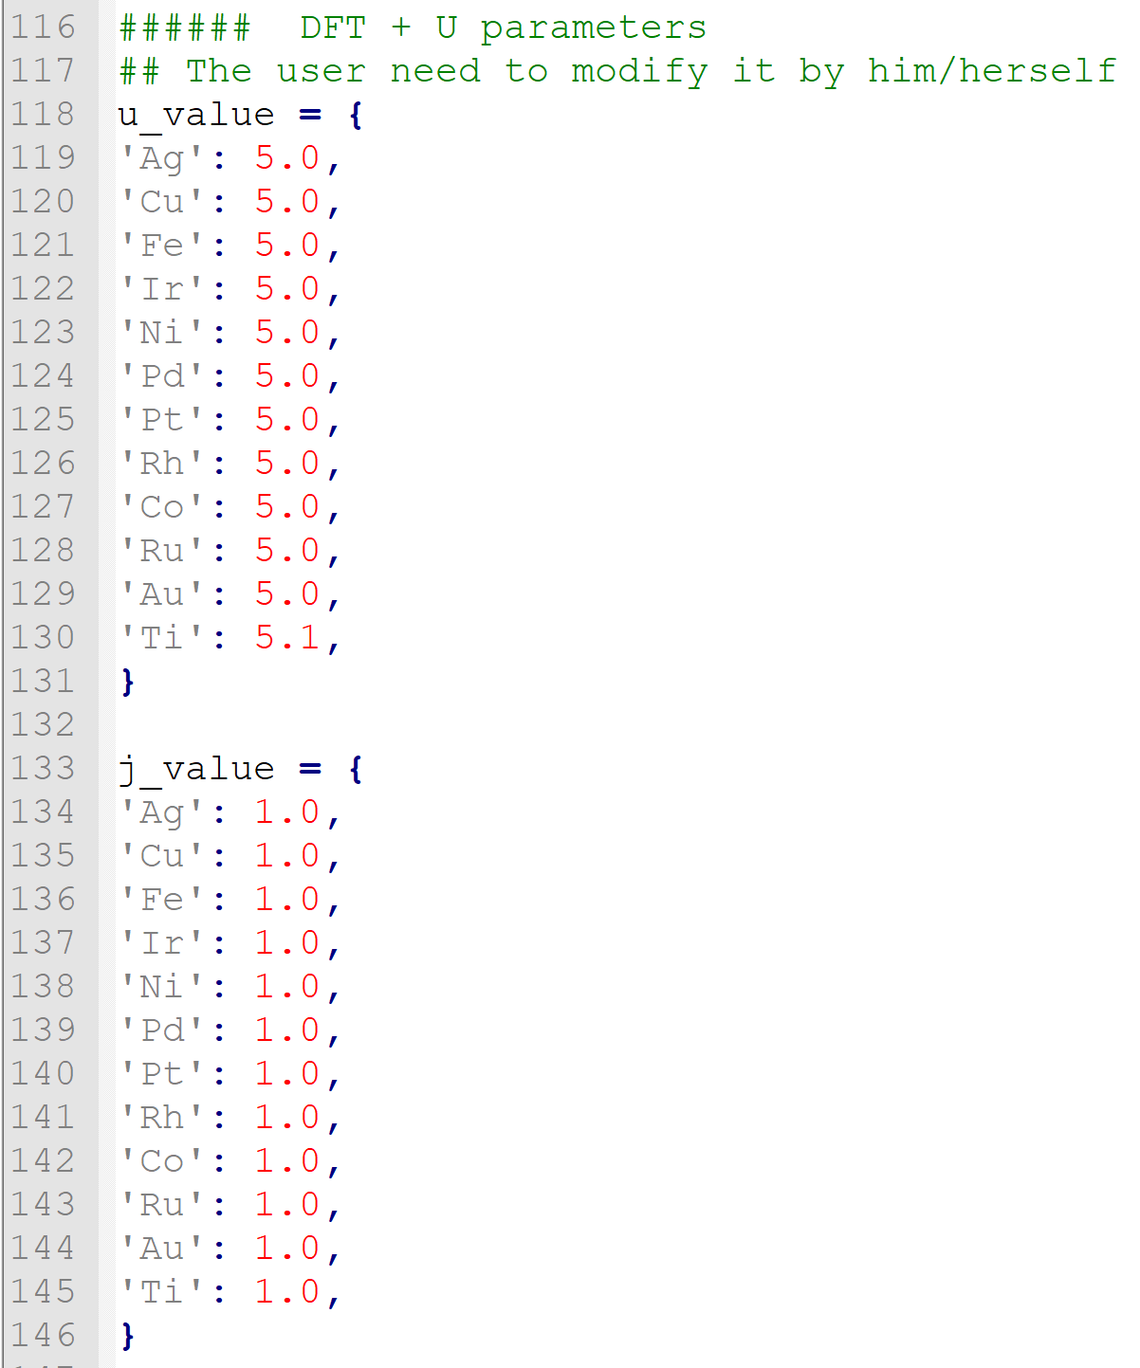
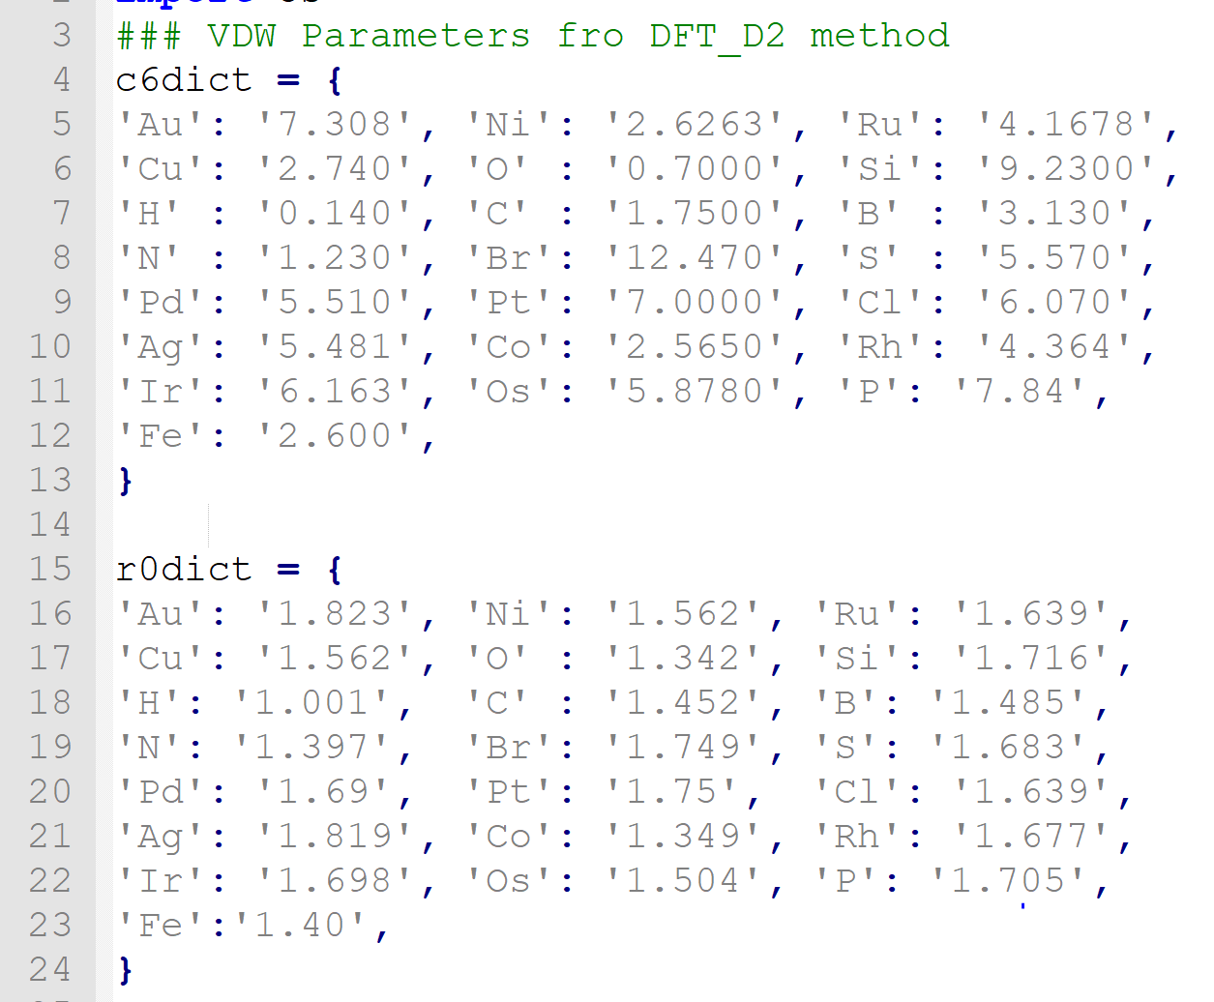
INCAR
INPUTS
DFT-D2, DFT+U:
~/bin/Q_robot/brain/data.py
in.py dftd2 = d2-dict.py
in.py dftu = dftu.py
Many thanks to Neyvis and Rodrigo

Slide 9
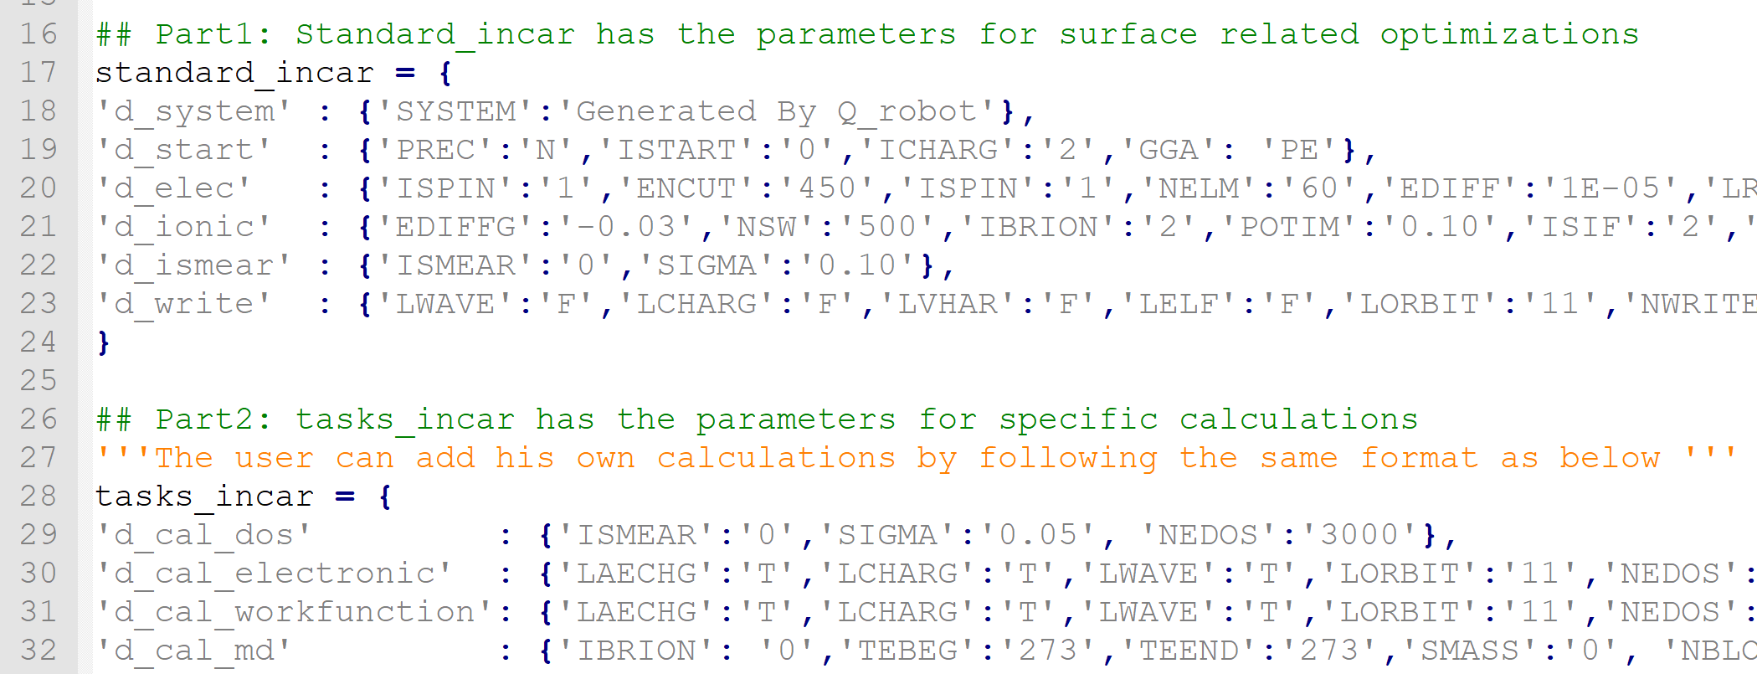
INCAR
INPUTS
Create Your own tasks
1）~/bin/Q_robot/brain/incar.py
2）Python dictionary format

Slide 10
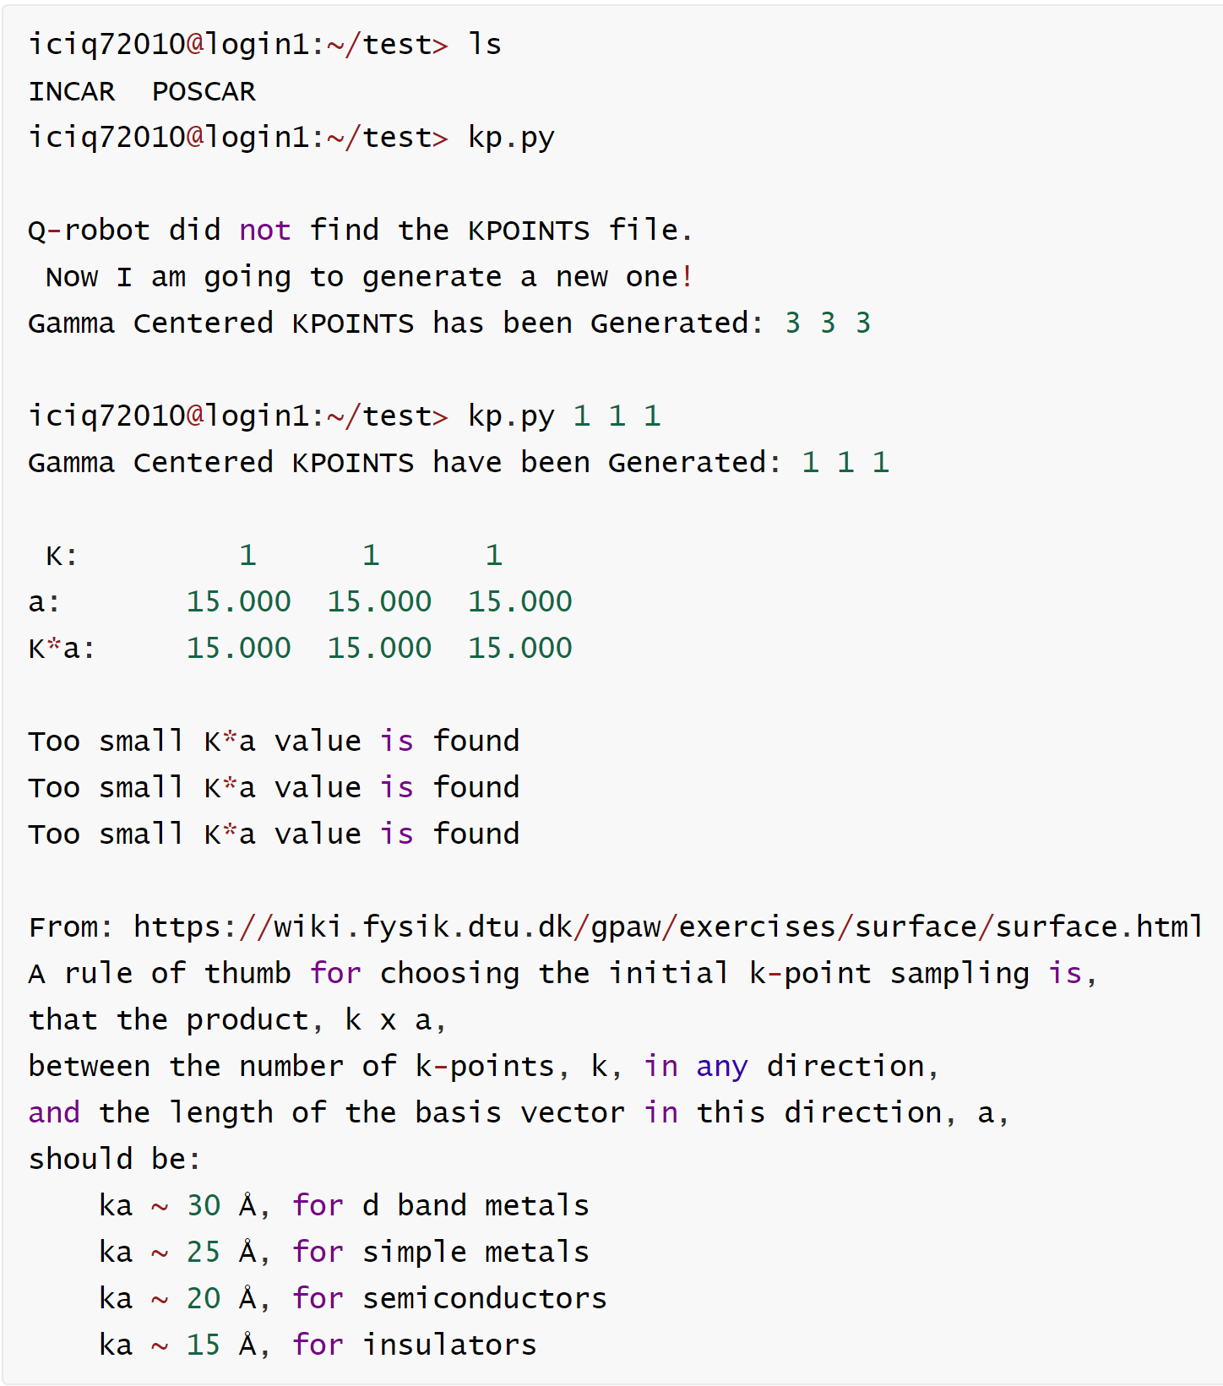
KPOINTS
INPUTS
To Generate the KPOINTS file
Unsupervised model
kp.py
if POSCAR exist: K * a ~ 30-40
else: gamma centered: 3 3 1
2) Supervised model:
kp.py 4 5 6
The same as Rodrigo’s kpoints.sh

Slide 11
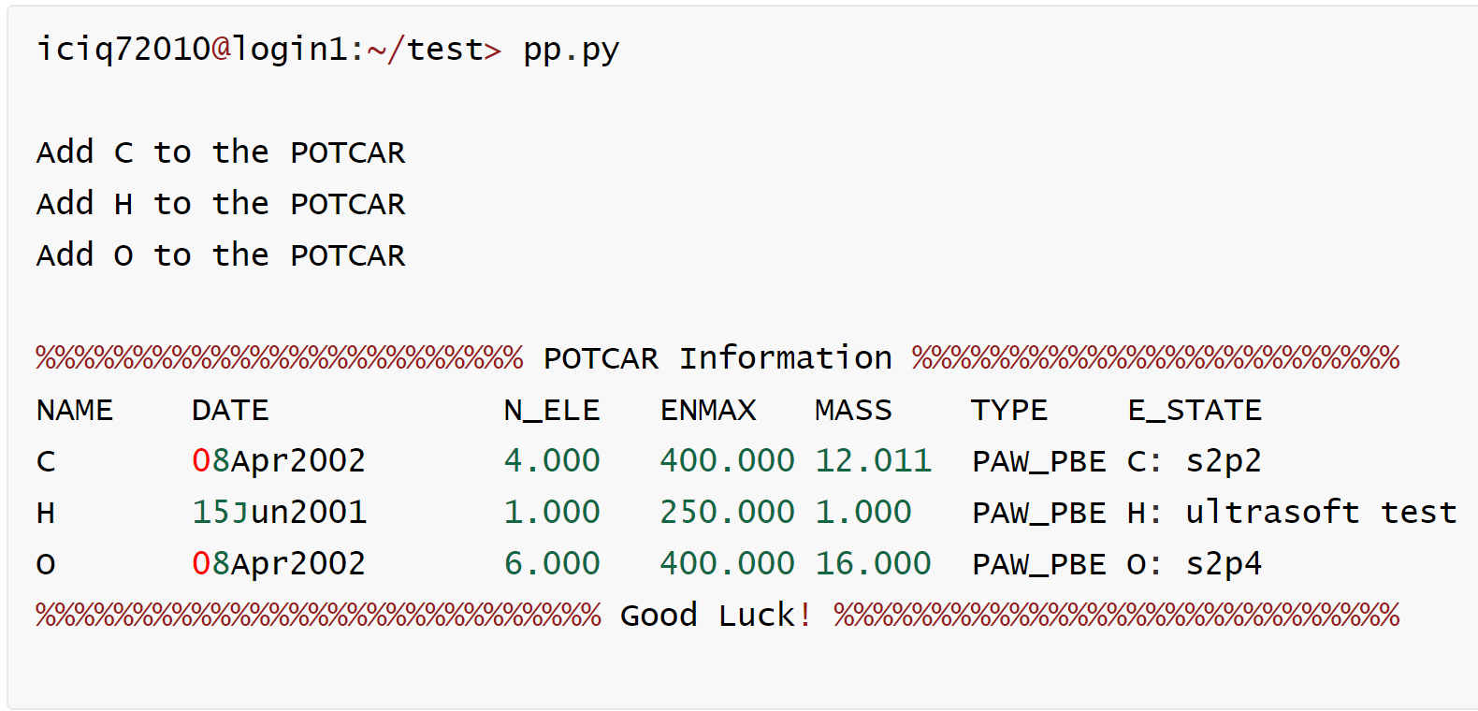
POTCAR
INPUTS
To Generate POTCARs
Unsupervised model:
pp.py
2) Supervised model:
pp.py ele1 ele2 ..
The same as Rodrigo’s potcar.sh

Slide 12
POSCAR, CONTCAR: lattice.py
INPUTS
add.py | To copy atom(s) from one POSCAR1 to the end of POSCAR2
move_atoms.py | To copy the atoms from one POSCAR1 to POSCAR2, similar to add.py
delete.py | To delete atom(s) from POSCAR/CONTCAR
dire2cart.py | To convert the Direct to Cartesian Coordinates; Fix the specific layers from inputs
fix_atoms.py | To fix and relax the atoms by your inputs
get_abc.py | To get the lattice vectors, length from our models
rotate.py | To rotate the atoms any degrees around the axis from your input
sortcar.py | To sort the coordinates of each element in the z directions
switch.py | To get all the possibilities of switching two atoms from two layers; For segregation, islanding calculations
translate.py | To shift, translate or move atoms in the POSCAR file
xps.py | To move the atom at the very beginning in POSCAR for XPS calculations.
cssm.py | To cleave the stable surfaces of metals: based on ASE modules and data.py.
Note: All actions are based on Cartesian format

Slide 13
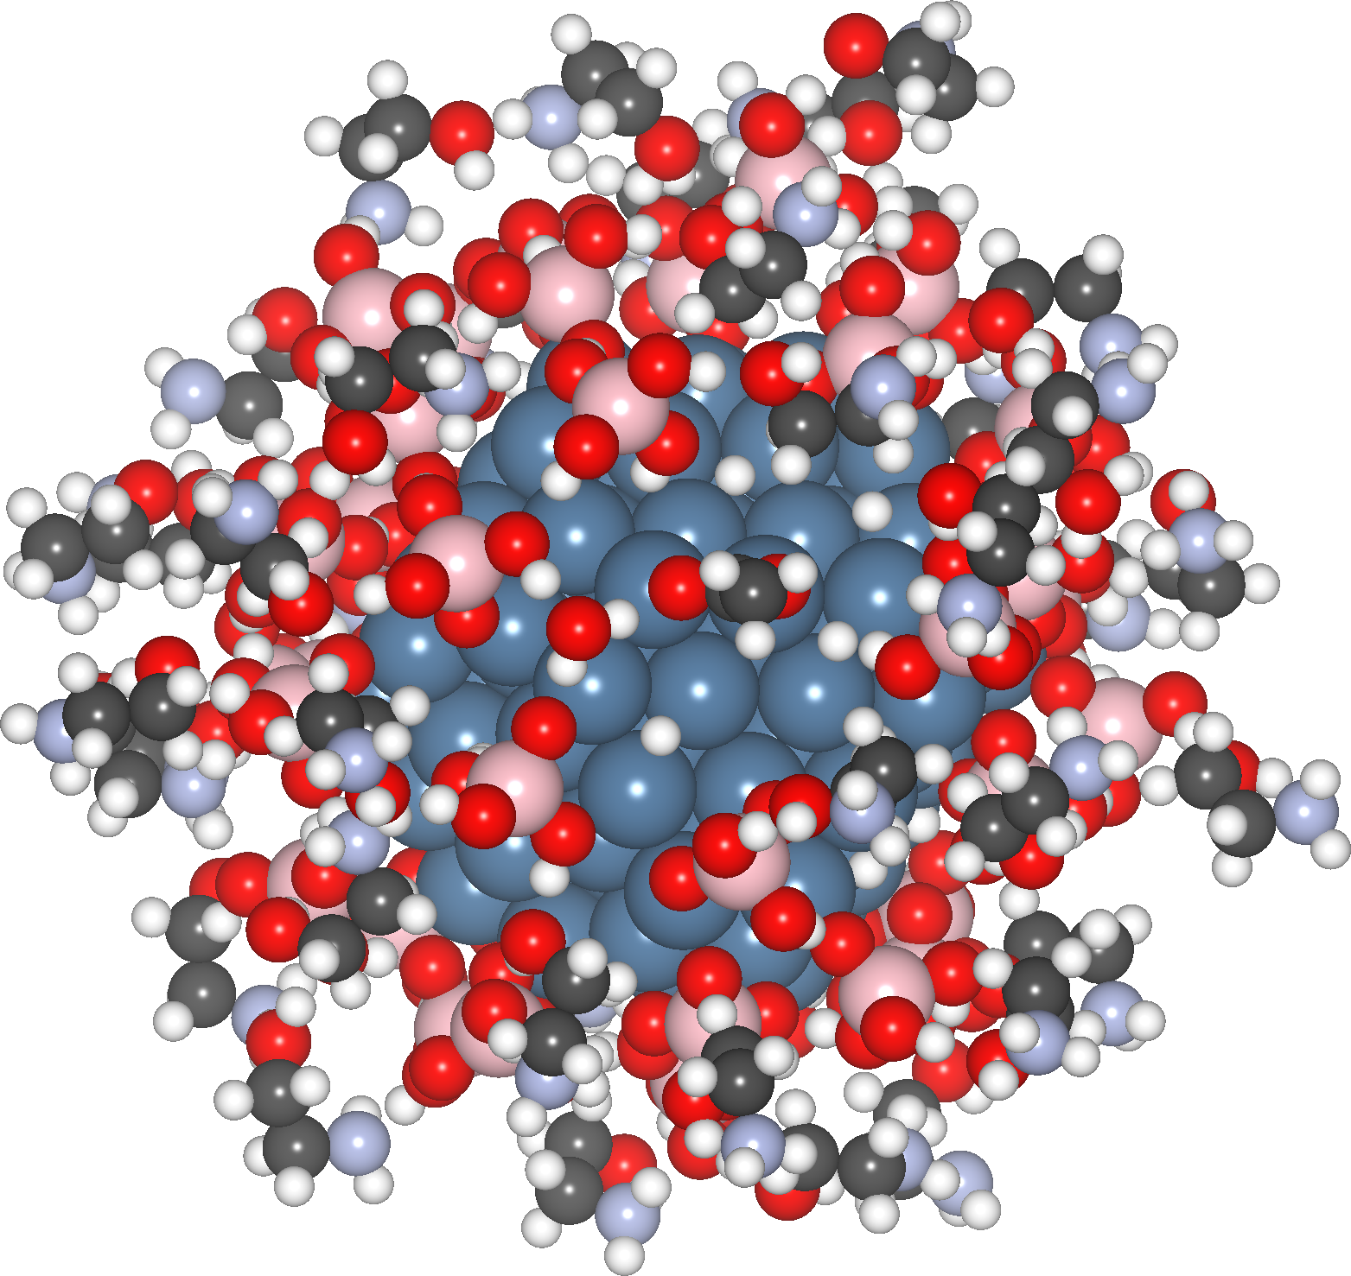
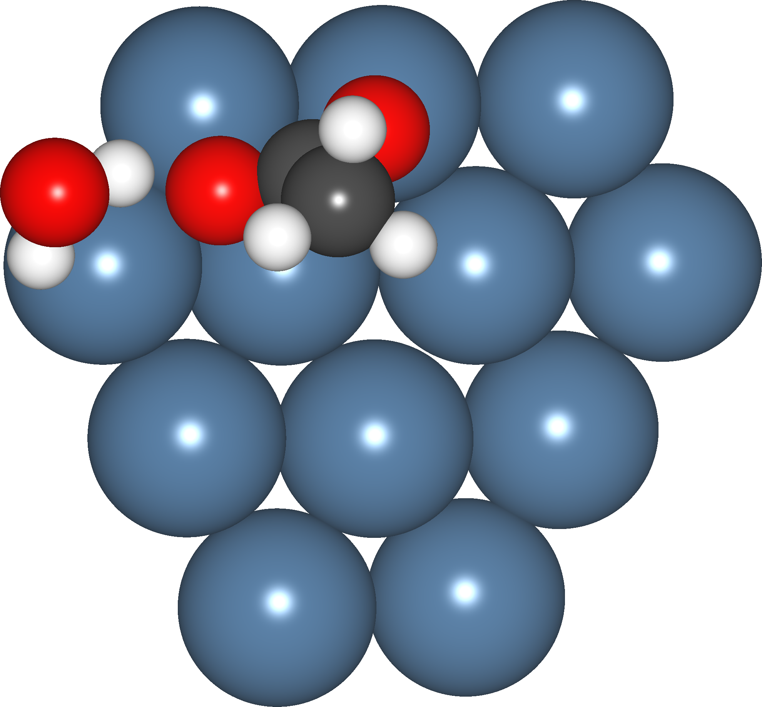
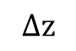
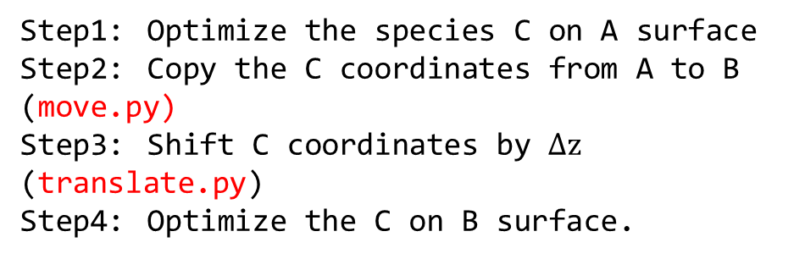
Applications
INPUTS
C
C
$$∆z$$
Surface-A Surface-B
Step1: Optimize the species C on A surface
Step2: Copy the C coordinates from A to B (move.py)
Step3: Shift C coordinates by $∆z$ (translate.py)
Step4: Optimize the C on B surface.
Step1: Optimize the structure with small model
Step2: Copy the results to large model
Step3: Optimize the large model

Slide 14
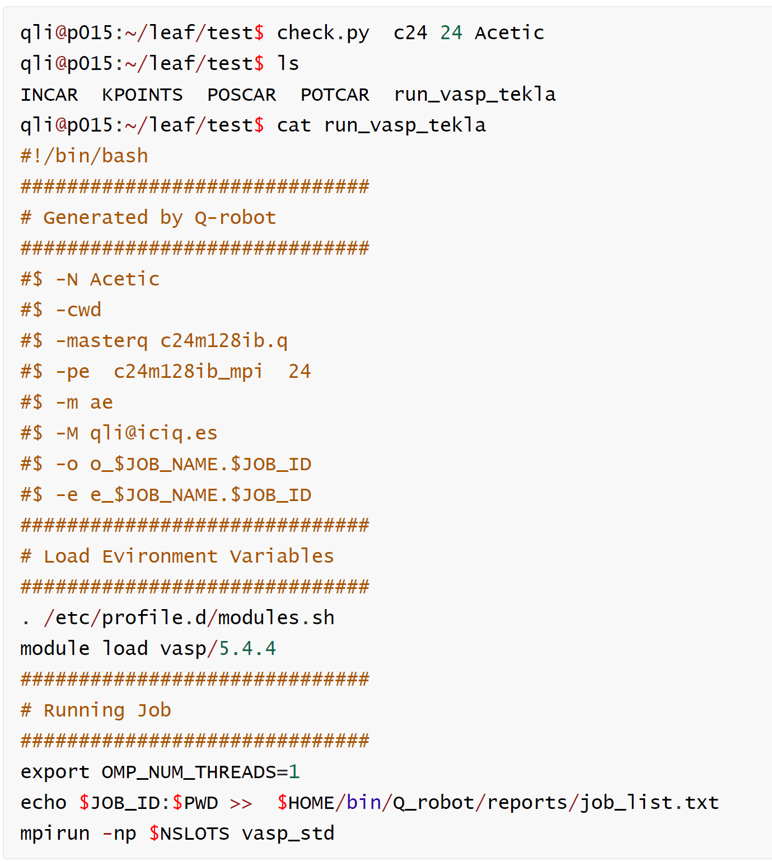
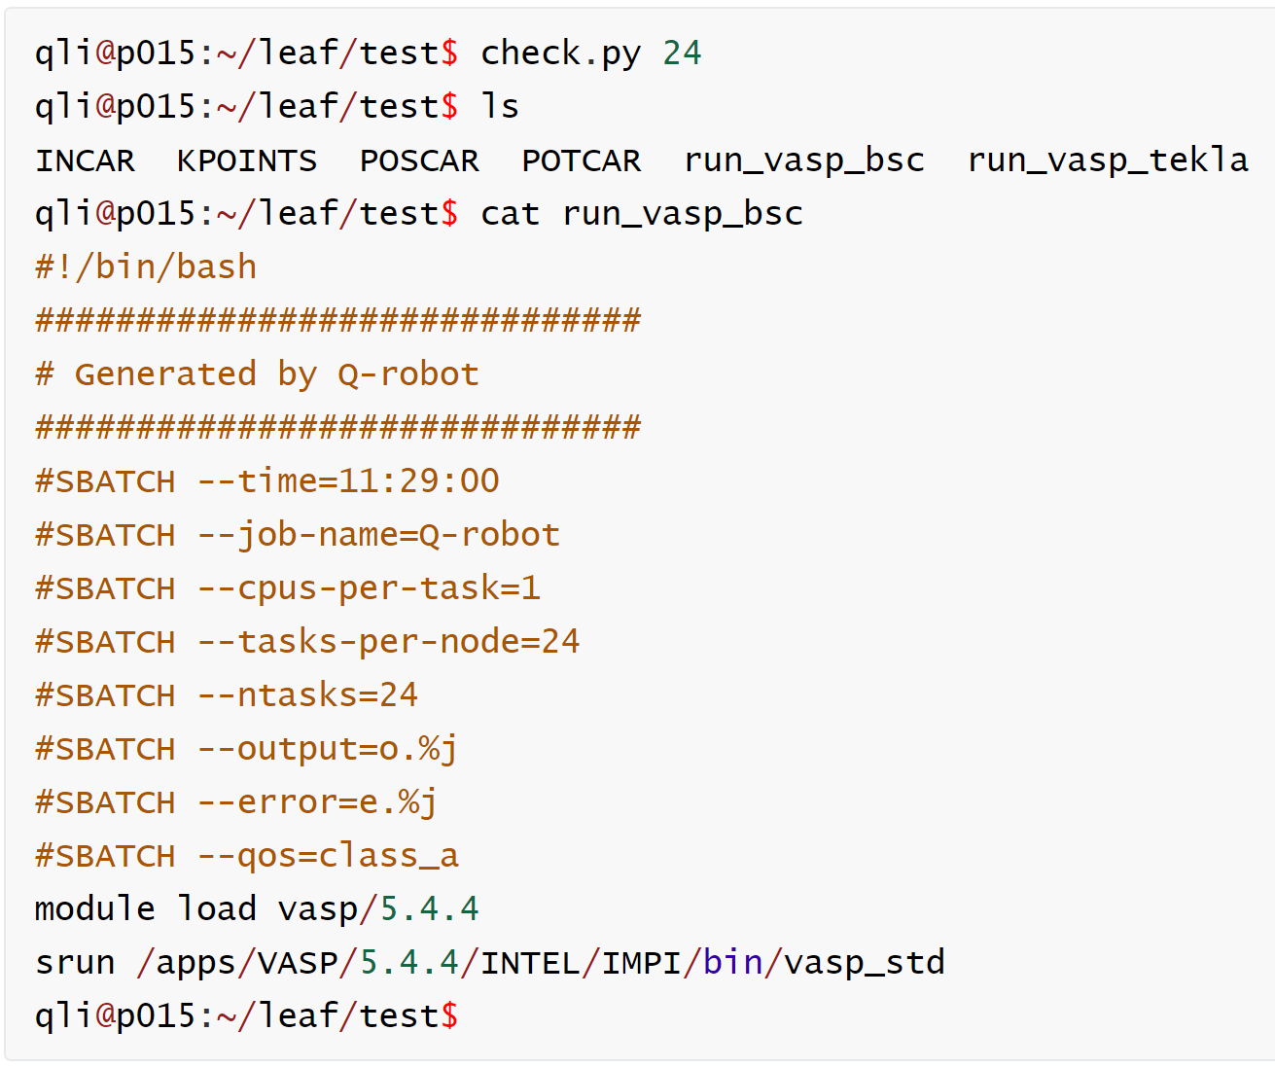
run_vasp
Run
For Tekla: For BSC:
check.py queue cores job_name check.py cores job_name
Record the job_ID, path

Slide 15
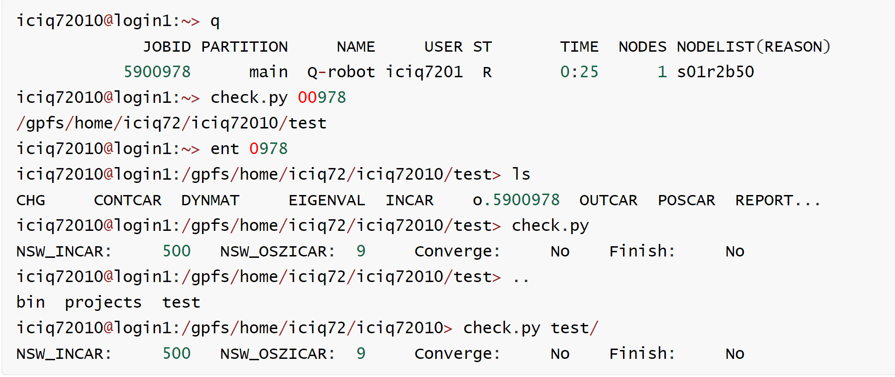
run_vasp
Run
vim ~/.bashrc file
myfunction4() { cd $(check.py $1); }
alias ent=myfunction4
Get the job path：
check.py job-ID
Get into the job path:
ent job-ID
Check the job status:
check.py job path

Slide 16
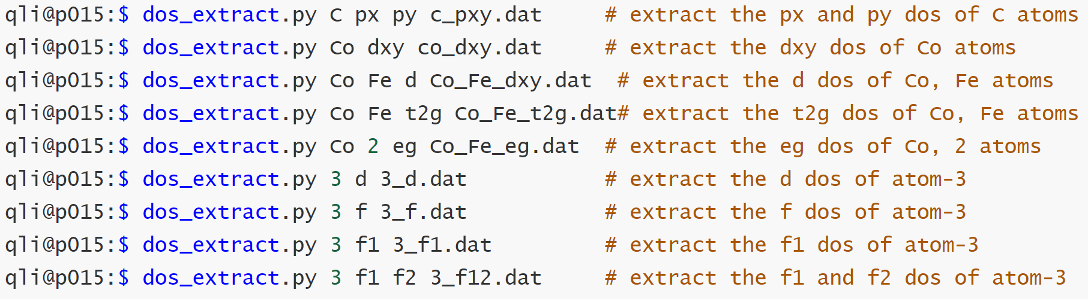
DOSCAR
OUT
dos_extract.py atoms orbitals output
Extract the DOS information
Free input style: arguments analyzer in lattice.py
Combine the atoms, the orbitals whatever you like

Slide 17
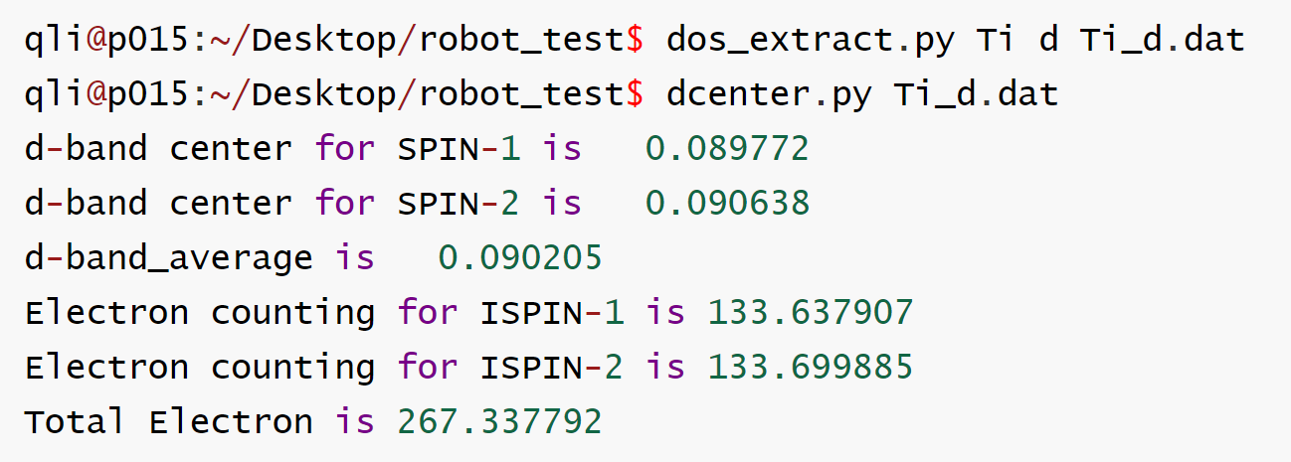
DOSCAR
OUT
dcenter.py:
1) To calculate the
s, p, d, f band centers,
or combination of them,
depending on the dos information
2) Count the electron numbers
Notes:
,
it.

Slide 18
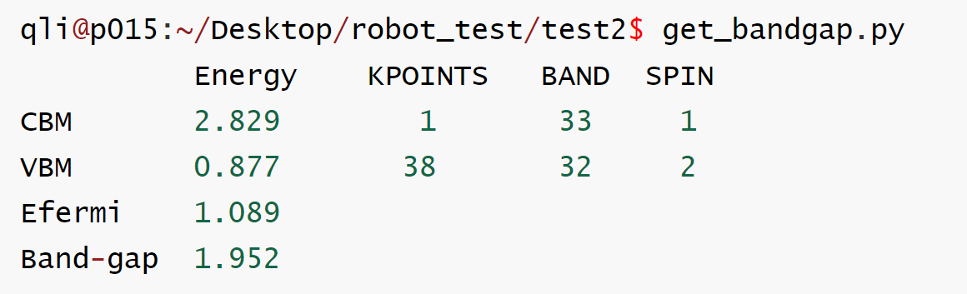
EIGENVAL and band information
OUT
get_bandgap.py：
To calculate the band gap from EIGENVAL file
pbeband.py + pbekpoints.py
To generate the data for plotting the band structure from GGA-PBE
hseband.py + pbekpoints.py + hsekpoints.py
To generate the data for plotting the band structure from HSE

Slide 19
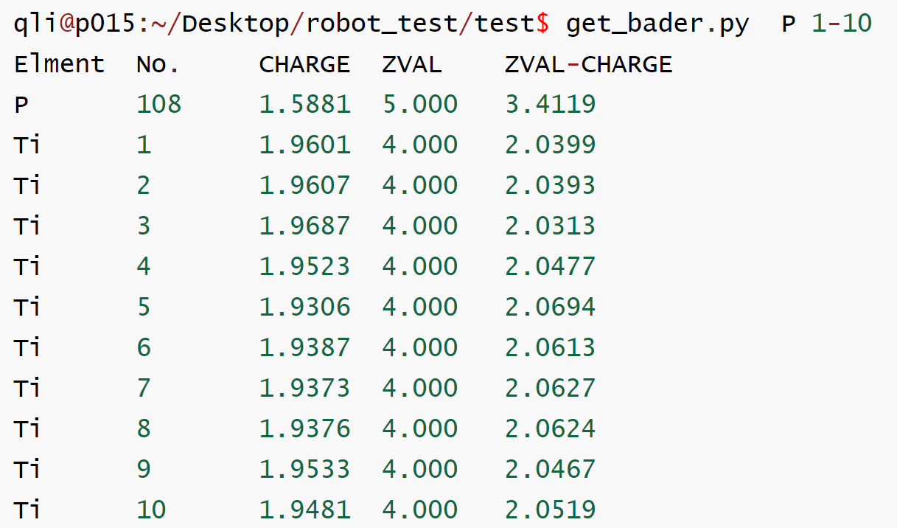
CHARGES
OUT
Run VTST commands first
chgsum.pl AECCAR0 AECCAR2
bader CHGCAR -ref CHGCAR_sum
To get the ACF.dat file
get_bader.py atoms
Calculate the Bader Charges
from ACF.dat and POTCAR

Slide 20
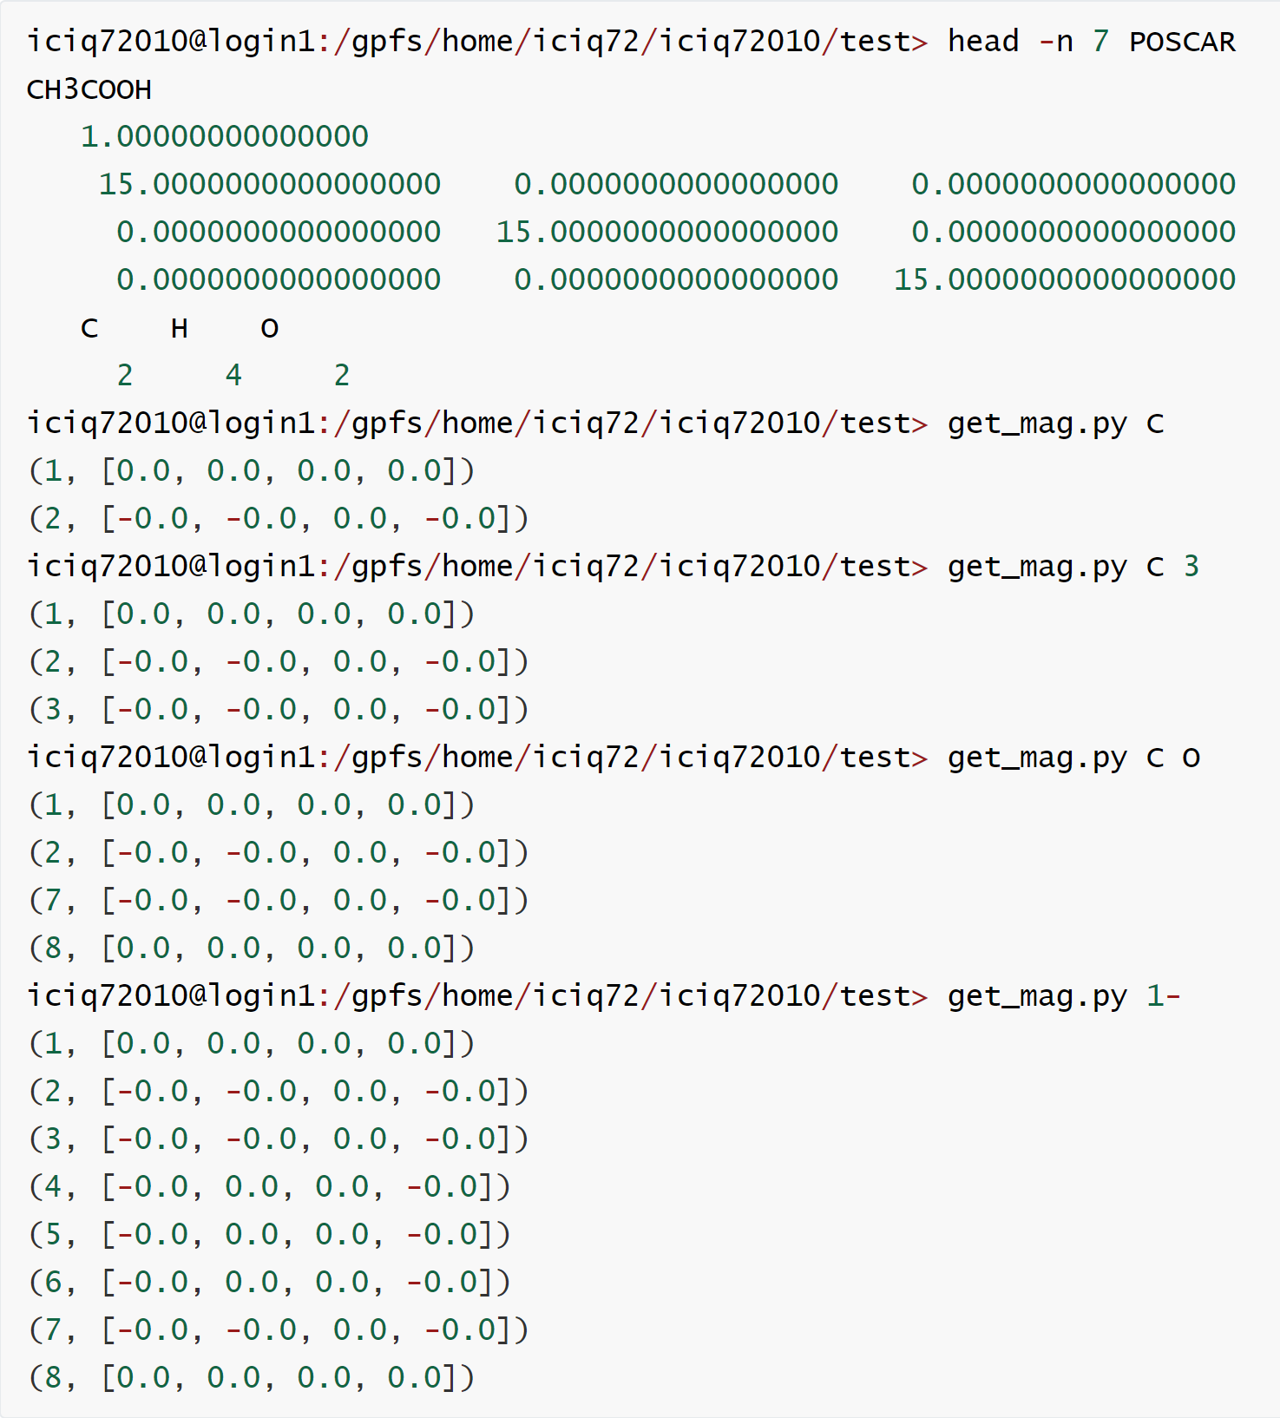
Magnetization
OUT
get_mag.py atoms
To get the magnetization of
atoms from OUTCAR
Note:
Add LORBIT = 11 to INACR

Slide 21
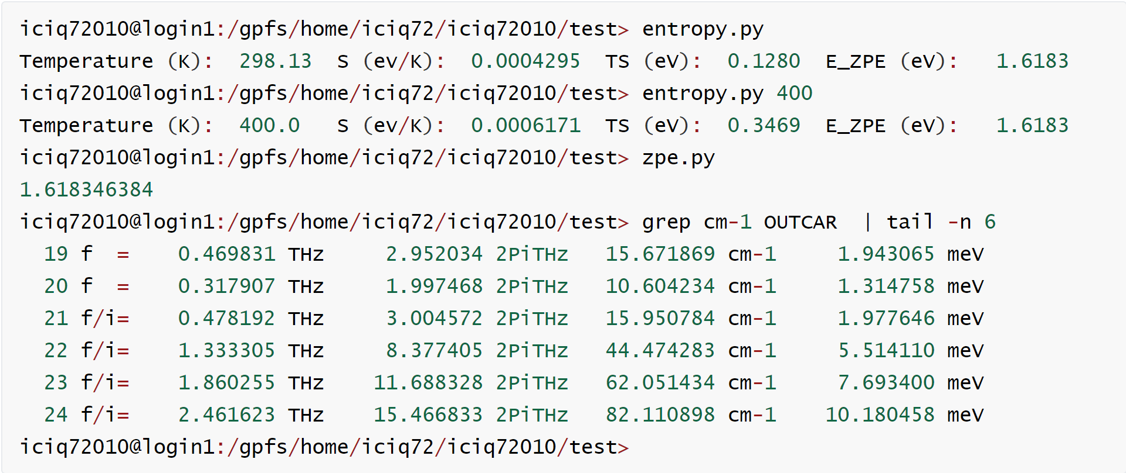
Entropy and ZPE
OUT
To calculate Entropy:
entropy.py Tem
To calculate ZPE:
zpe.py
Notes:
1 Be careful of the modes with low wave numbers;
2 Imaginary Frequencies are not considered.

Slide 22
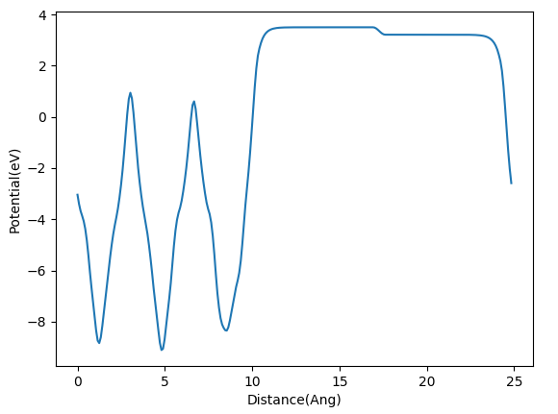
Work function
OUT
Step1:
Generate LOCPOT_z file:
vtotav.py LOCPOT z
Step2:
plot the workfunction:
wplot.py

Slide 23
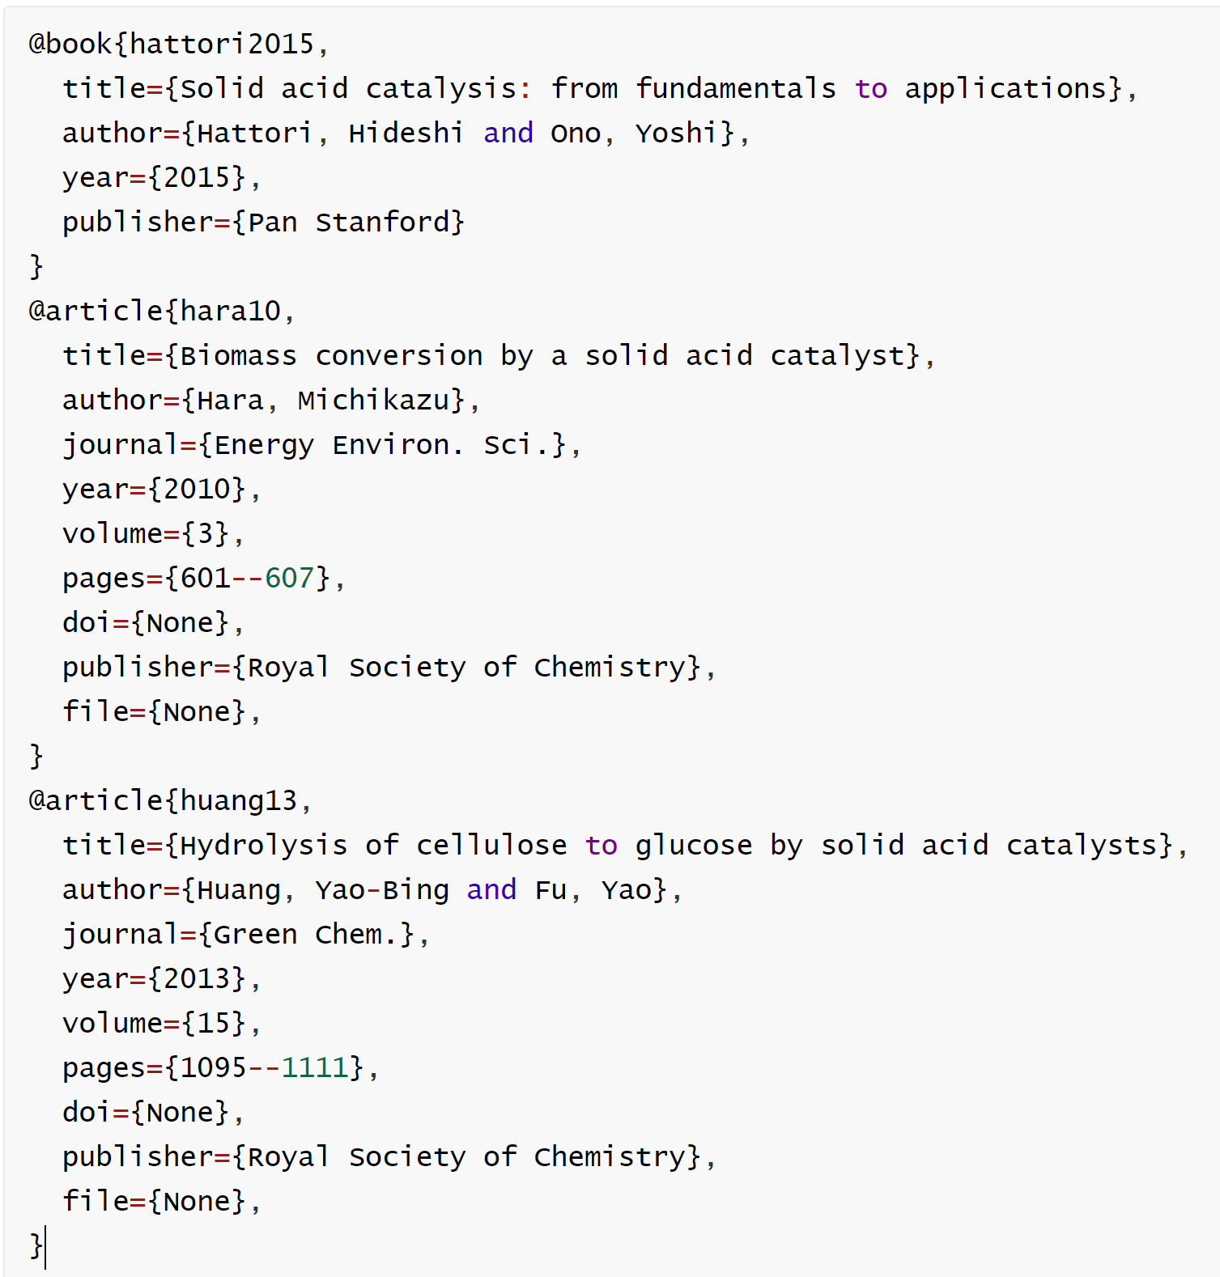
References
Read_papers
get_bib.py
Read the PDF files
Search:
Journal webpage
google scholar
Download the bib file automatically.
bib_reader.py
Read bib file
Analyze the Entries and fields
Unify the bib format
Print them in a nicer way

Slide 24

Updates
Module based on vasprun.xml file
From Python2 to Python3.
Tutorials
Acknowledgements
Thank All the s in NL Group!

